Slide 1




a re n po s li s
Ma
nu
f
ctu
rs of Precisio
Com
ne
n
ts
& As
e
m
b
e
Formerly known as Micro Turners

Slide 2

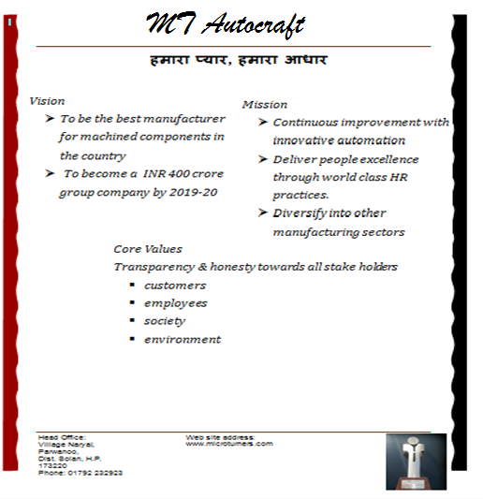
Mission, Vision and Core Values

Slide 3



Introduction
Establishment - 1983
CEO- Mr. Anil Sehgal
ISO/TS16949 certified Company
Head-Office – Parwanoo (Himachal Pradesh)
Leading Manufacturers of Precision Components & Assemblies
Catering to Automotive & Farm Equipment
MT Grp Turnover (FY 16~17) –146.14 Cr.
KHM Turnover (FY 16~17) – 126 Cr.
Total Turnover (FY 16~17) – 272.14 Cr.
Passenger Car Division (Head Office)
Rocker Arm Division (Dedicated to M&M)
Connecting Rod Division (Dedicated to M&M)
KHM Drive Systems
MT Autocraft -Manesar
MT Autocraft- Rohtak
Manufacturing Plants

Slide 4
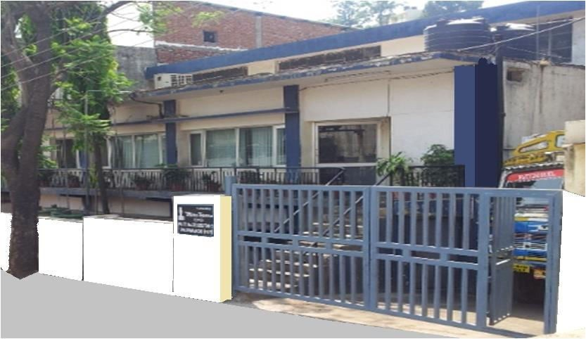
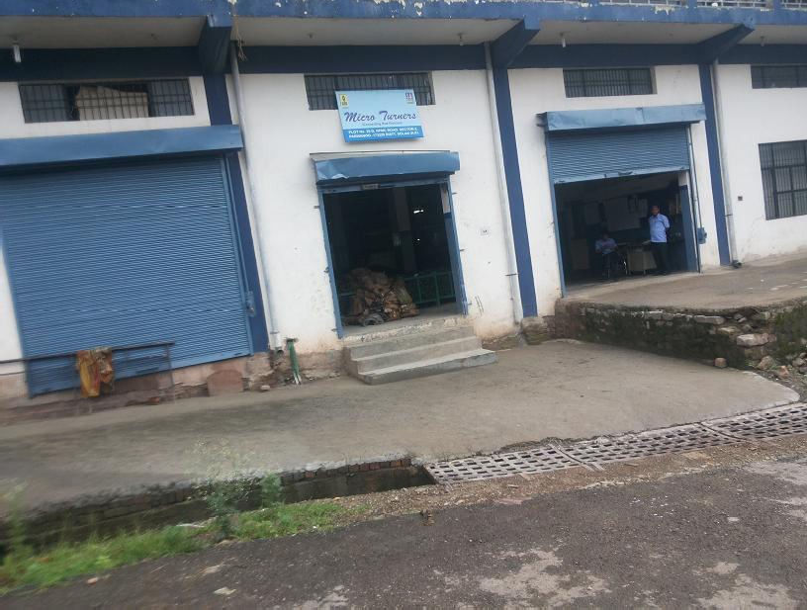
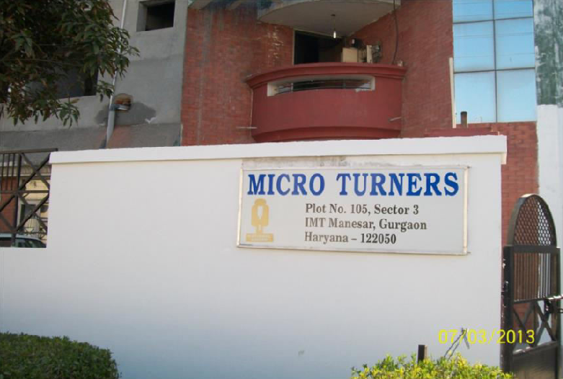
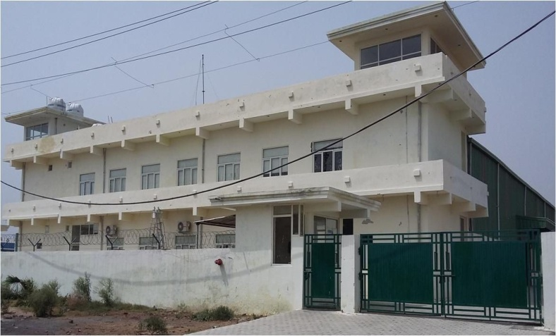
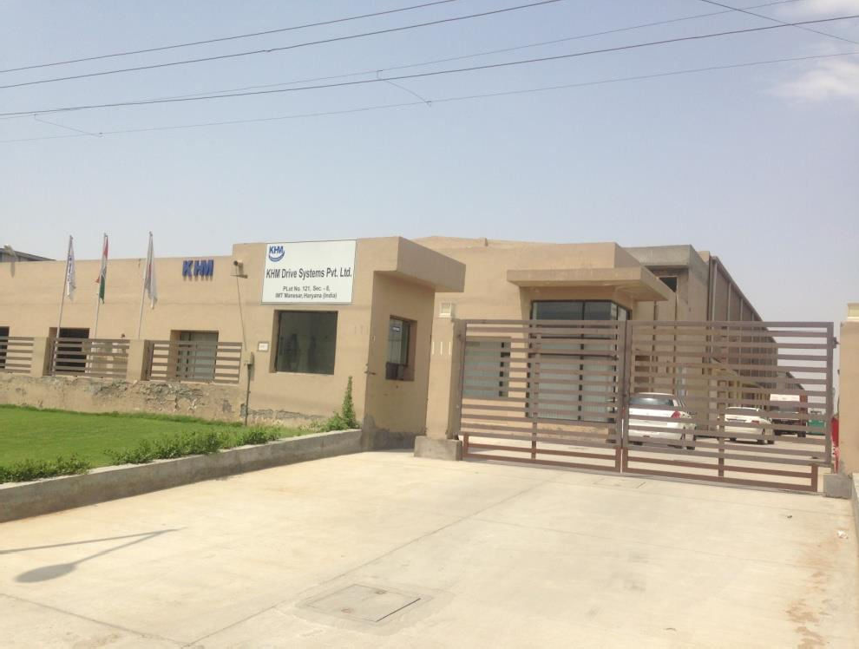
MT Autocraft Plant Photographs
Parwanoo Mother Plant (60,000 Sqft)
TPD, Parwanoo (Dedicated to M&M) (20,000 Sqft)
CRD, Parwanoo (Dedicated to M&M) (10,000 Sqft)
MT Autocraft MANESAR (20,000 Sqft)
MT Autocraft Rohtak (54,000 Sqft)
KHM DRIVE SYSTEMS,Manesar (54,000 Sqft)

Slide 5
Achievements
Unit was awarded with a national award for out standing small-scale entrepreneurship by the President of India in the year 1987
We are producing more than 1 million shaft type components per month
We are preferred source of MSIL and most of our components are on single source basis
Manesar unit is producing 5000 assemblies / day on JIT basis for MSIL
More than 90% of MSIL, Maruti Powertrain & 100% of Mahindra Transmission shaft requirements are met by us
❖
For Honda 100% requirement of Shifting shafts is being met by us
We have been awarded by Maruti for Vendor Performance “SPECIAL SUPPORT” for the year 2009-2010
In Year 2012-13 we had been awarded for “FOCUSED COST DOWN” by MSIL
In Year 2013-14 we have been awarded for “MANUFACTURING EXCELLENCE” by MSIL
In year 2014-15 KHM has been awarded for “Overall Excellence” by MSIL
In year 2016-17 we have been awarded “No Limits Award “ by M&M

Slide 6
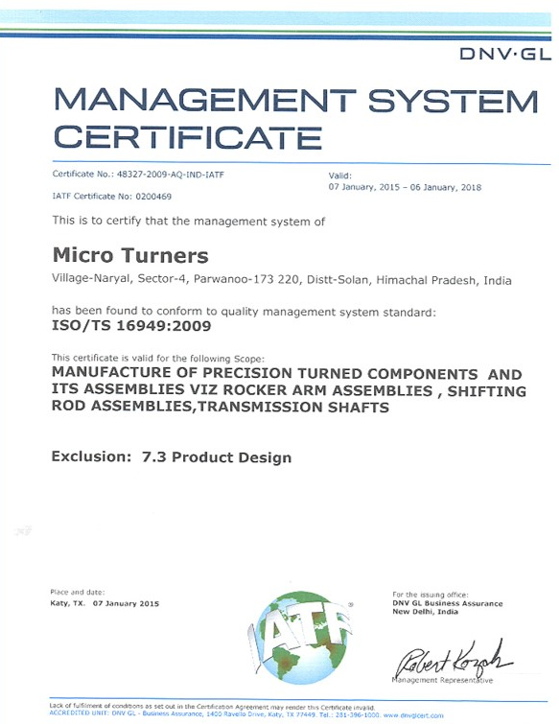
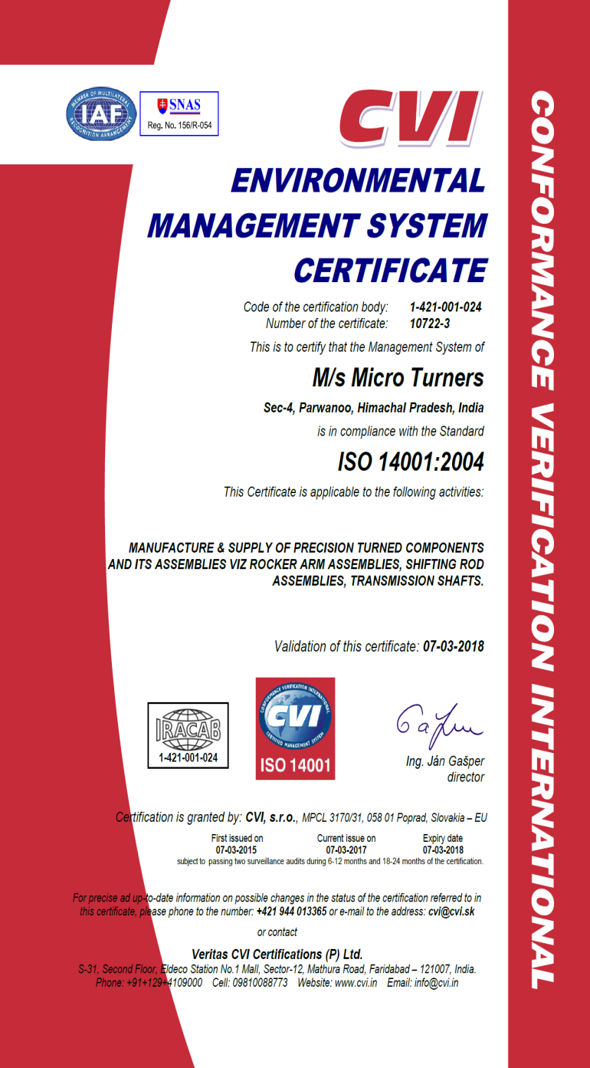
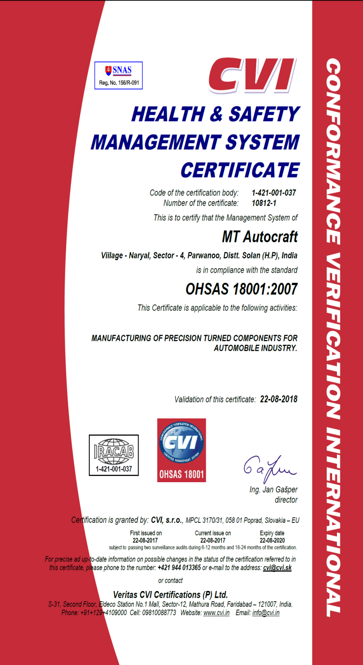
QMS Certificates
ISO/TS 16949 : 2009
ISO 14001: 2004
OHSAS 18001:2007
8

Slide 7


MT AUTOCRAFT Joint Venture
KHM Drive Systems is a Japanese Joint Venture between three companies.
K- KORITU (Japan)
Designing and machining components manufacturers
http://www.koritu.co.jp
H- HAYASHI KOGYO (Japan)
Precision Sheet Metal manufacturers
M- MT AUTOCRAFT (India)
Precision component and Assembly Manufacturers

Slide 8

















List Of Esteemed Customers

Slide 9

Customers With Business Volume
Customers | Abbreviated As | Business Volume
Mahindra & Mahindra Ltd. | M&M | 45.96%
Maruti Suzuki India Ltd. | MSIL | 37.68%
Honda Car India | HONDA | 5.77%
Tractors & Farm Equipment | TAFE | 1.24%
General Motors & Ford (through Avtec Ltd.) | OTHERS | 10.6%
Business Volume in %age

Slide 10
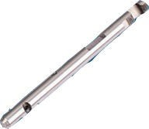
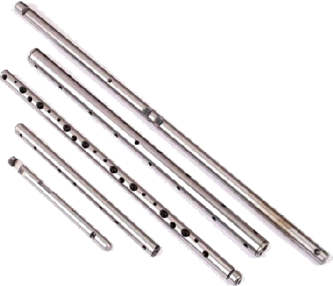
Transmission Shafts-Product Range
Shafts - Capability
Maximum Length Maximum Dia Tolerance on Grinding Tolerance on CD hole Roundness
Quantity Mfg. Per Month
520mm 025mm 0.01mm 0.01mm 0.006mm
2,25,000
Rocker Shafts - Capability
450mm
Deep Hole Drilling
Tolerance on Grinding Quantity Mfg. Per Month
0.01mm 52,000

Slide 11
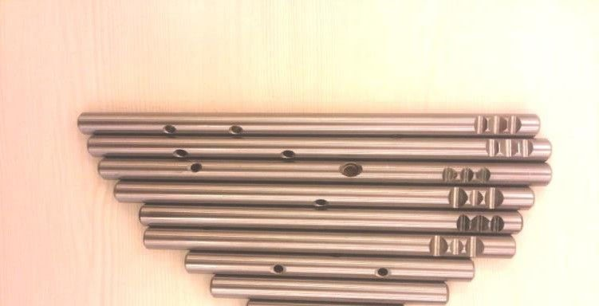

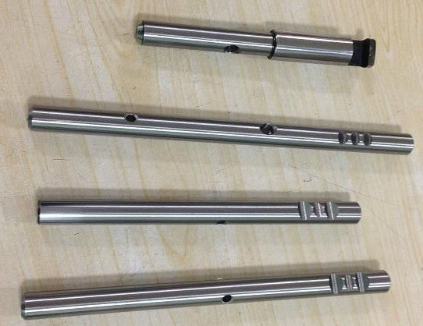
Honda Shafts
TRANSMISSION SHAFTS---HONDA DIESEL
Quantity Mfg. Per Month : 14,000 Sets
TRANSMISSION SHAFTS---HONDA PETROL
Quantity Mfg. Per Month: 10,000 Sets

Slide 12
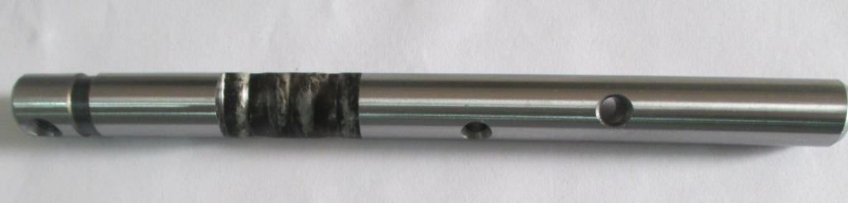
Transmission CAM SHAFT
SHAFT FOR FORD
3D machining

Slide 13
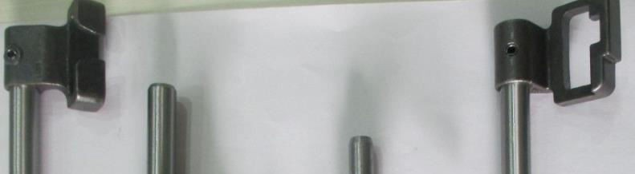
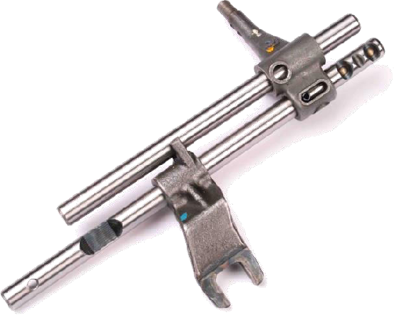
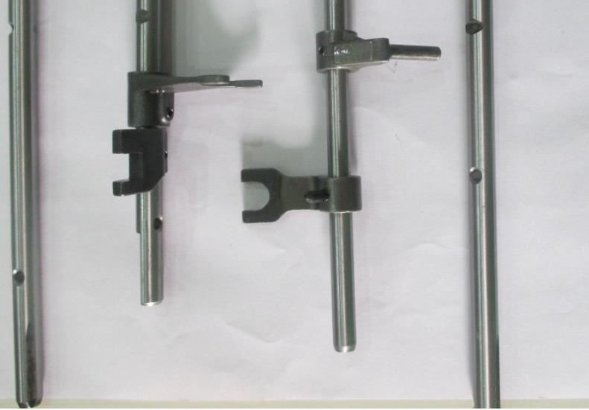
Transmission Assemblies
COMMON DRILLING TYPE TRANSMISSION ASSEMBLIES

Slide 14
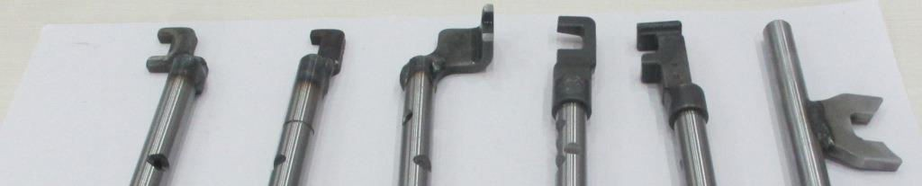
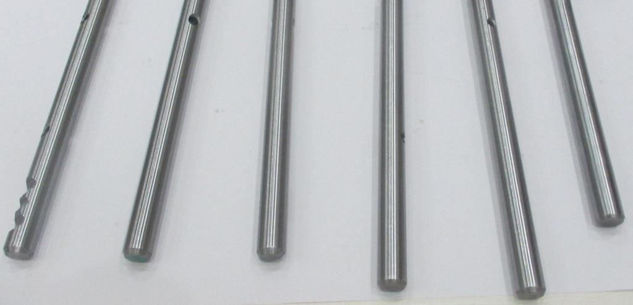
Transmission Assemblies
WELDED TYPE TRANSMISSION ASSEMBLIES

Slide 15
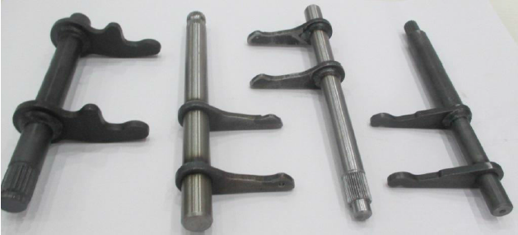
Transmission Assemblies
CLUTCH RELEASE SHAFTS

Slide 16
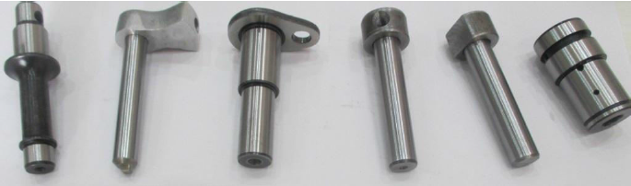
IDLER SHAFTS
IDLER SHAFTS

Slide 17
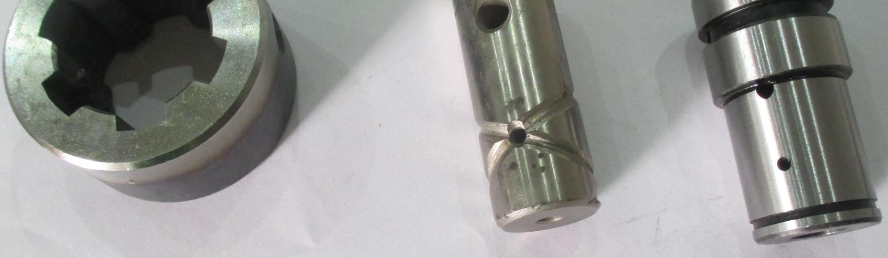
TURNED COMPONENTS
TURNED COMPONENTS

Slide 18
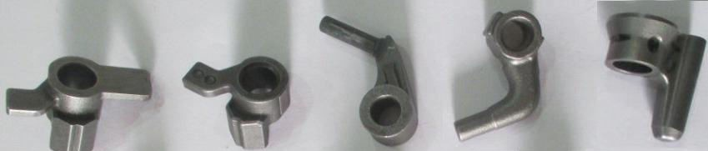
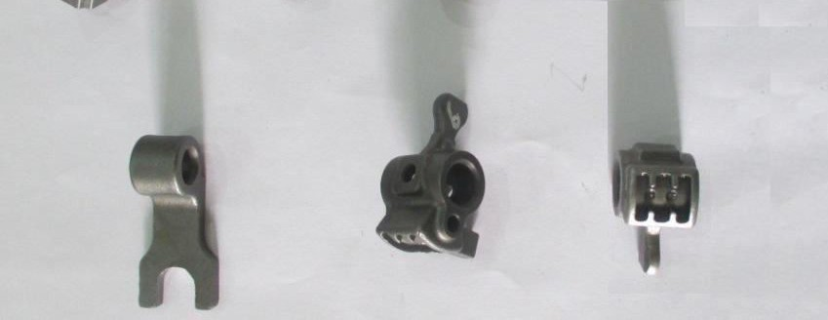
INVESTMENT CASTING COMPONENTS
INVESTMENT CASTING PARTS

Slide 19
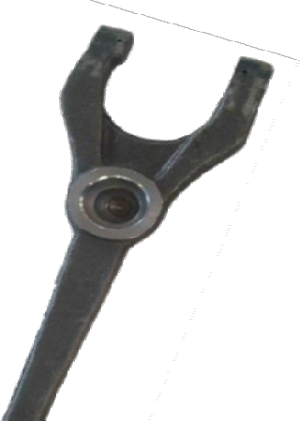


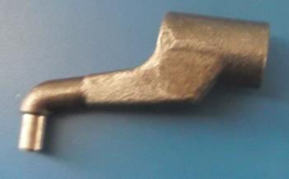
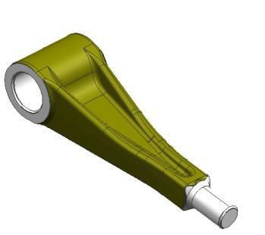
FORGING COMPONENTS
FORGED COMPONENTS
CUSTOMER | MAHINDRA
UNIT | PARWANOO PLANT
EXISTING PRODUCTION | 15,000/MONTH
MACHINES | CNC & SPM
CLUTCH RELEASE FORK
CUSTOMER | MSIL
UNIT | PARWANOO PLANT
EXISTING PRODUCTION | 40,000 PER MONTH
MACHINES | CNC & VMC
5th & Rev. Arm Forging

Slide 20
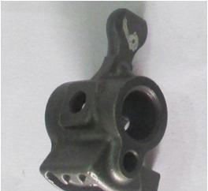
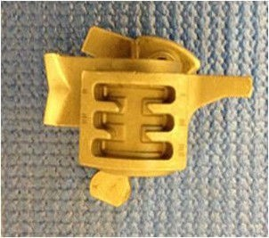
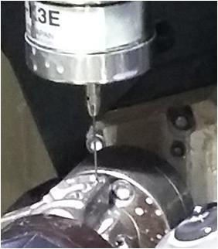
Transmission Assemblies
LGSS (LEVER, GEAR, SHIFT & SELECT)
CUSTOMER | MSIL
UNIT | PARWANOO PLANT
Exisitng Production | 25,000 / MONTH
MACHINES
4 AXIS VMC MACHINE
Coordinate inspection on VMC (Online Inspection)
Probe
3D machining
H Pattern machining
Part

Slide 21
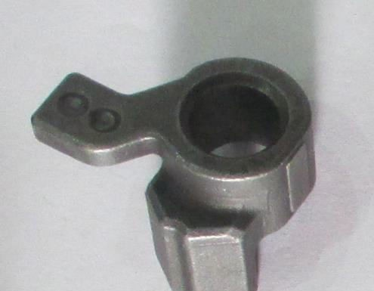

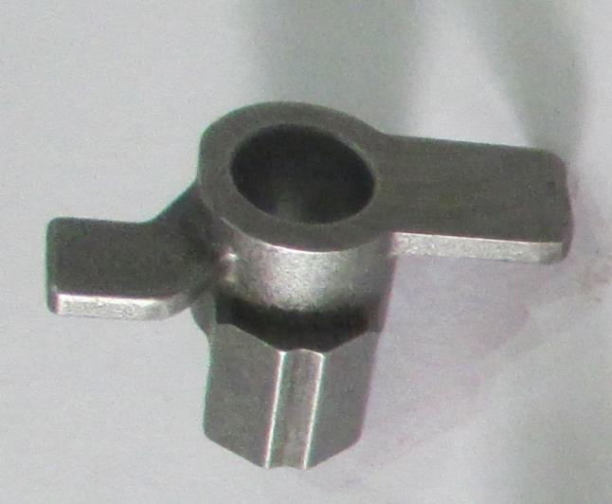
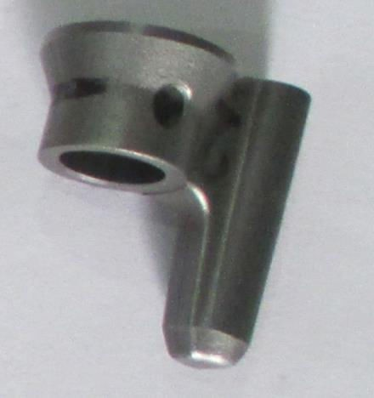
INVESTMENT CASTINGS
CAM
CUSTOMER | MSIL
UNIT | PARWANOO PLANT
CURRENT STATUS | IN MASS PRODUCTION FOR YP8 AMT
MACHINES | 4th AXIS VMC MACHINE
Very critical machining

Slide 22
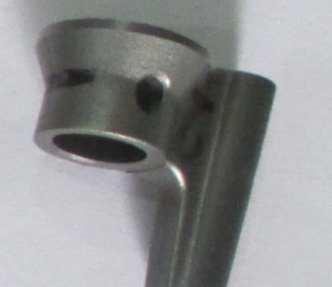

INVESTMENT CASTINGS
LEVER ENGAGE
CUSTOMER | MSIL
UNIT | PARWANOO PLANT
CURRENT STATUS | IN MASS PRODUCTION FOR YP8 AMT
MACHINES | 4 AXIS VMC MACHINE

Slide 23
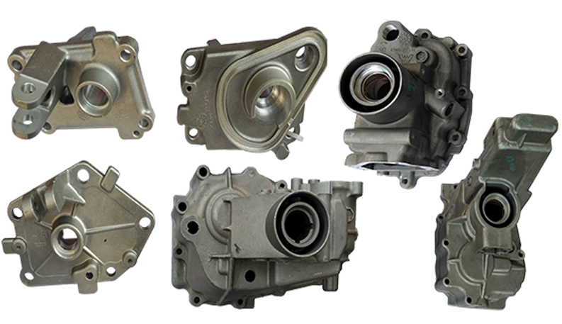
PDC CASTING PARTS
TRANSMISSION CASE
CUSTOMER | MSIL
UNIT | MANESAR PLANT
MACHINES | 4 AXIS VMC MACHINE
VEHICLES | OMNI, EECO & GYPSY
27

Slide 24
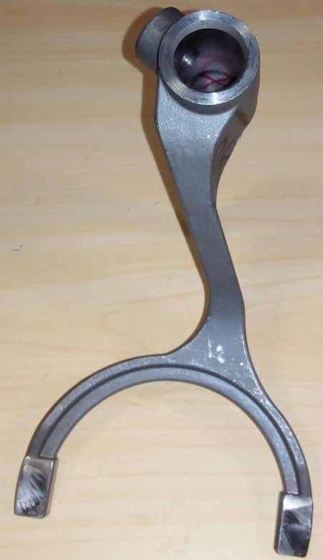
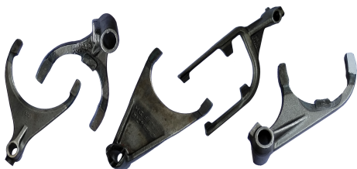
FORKS
FORKS
CUSTOMER | M&M & TAFE
UNIT | PARWANOO PLANT
EXISTING PRODUCTION | 40,000/ MONTH.
MACHINES 4 AXIS VMC MACHINE
ROUTE FORGING, INVESTMENT CASTING
FORK IN INVESTMENT CASTING

Slide 25
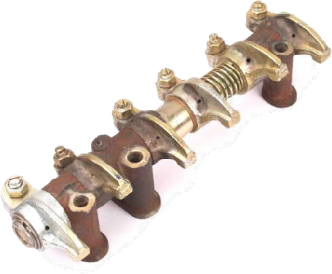
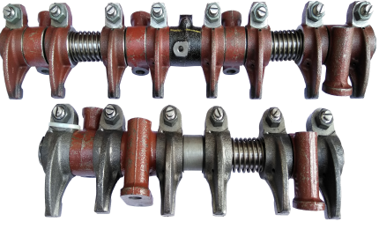
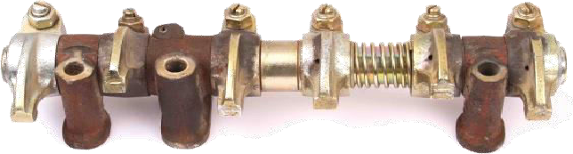
Rocker Arm Products
ROCKER SHAFT ASSEMBLIES
Quantity Mfg. Per Month
26,000
These Assemblies are treated with Ultra Sonic Cleaning, assembled in dust free atmosphere and tested for performance.

Slide 26
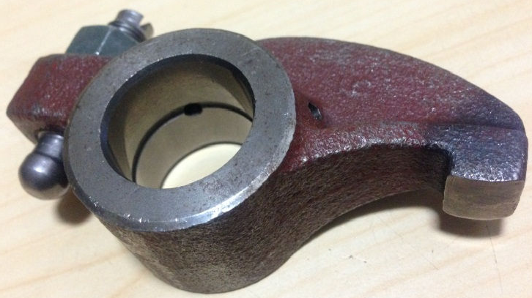
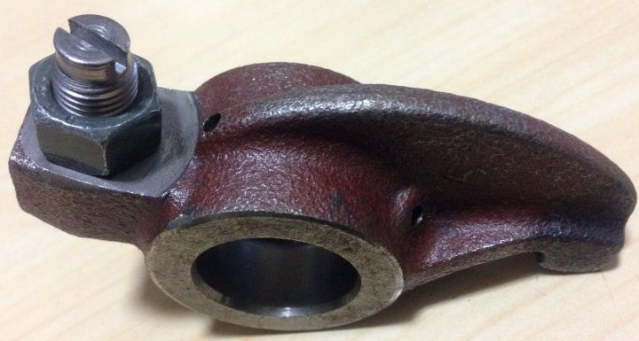
Rocker Arm Products
FORKS
CUSTOMER | M&M
UNIT | PARWANOO PLANT
EXISTING PRODUCON | 2,00,000/MONTH
MACHINE | 4 AXIS VMC MACHINE

Slide 27
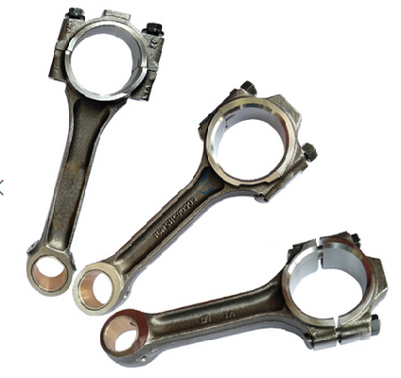
Connecting Rod Products
CONNECTING ROD
Quantity Mfg. Per Month 33,000 nos
Unlike conventional setup, these Con-Rods are machined on modern VMC setup, and tested with all critical parameters along with grading

Slide 28

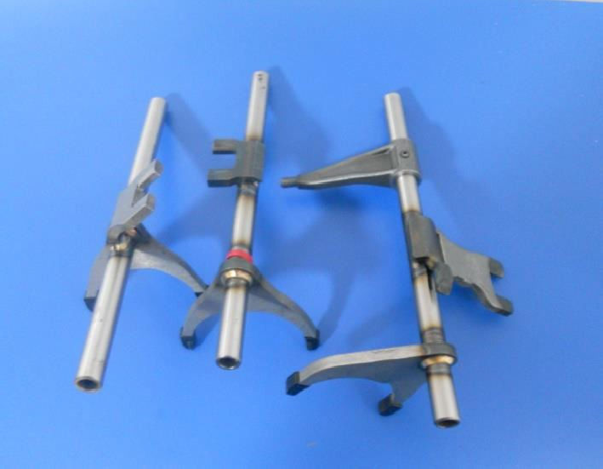
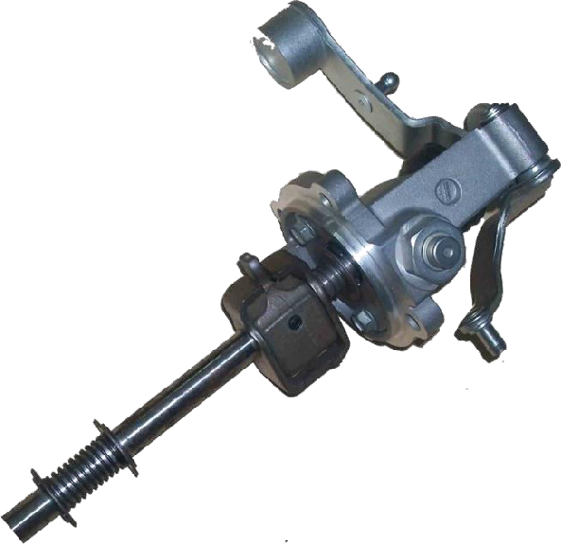
KHM– Product Range
SHIFTER FORKS
Capacity Planned per Month
75,000
SHIFT TOWER
Quantity Mfg. Per Month
40,000

Slide 29
MT AUTOCRAFT – Machining Facilities
S No. | Machine Types |  | Qty (nos)
1. | Automats |  | 15
2. | Milling Machines |  | 39
3. | Special Purpose Machines |  | 31
4. | Turning Centers / CNC Sliding Head |  | 15+5
5. | Vertical Machining Centers |  | 70
6. | Induction Hardening |  | 28
7. | MIG Welding / Robo Welding |  | 12+1
8. | Electroless Nickel Plating Plant |  | 1
9. | Plasma Welding Robots (KHM) |  | 21
10. | Servo Distortion Correction Press (KHM) |  | 18
11. | All Electrical Drive Injection Molding Press (KHM) |  | 2
12. | Thread & Spline Rolling Machines |  | 2
13. | Surface & Internal Broaching Machines |  | 3
14. | Fully Automatic Shift Tower Line (KHM) |  | 5
15. | Centerless / Cylindrical / CNC Cylindrical Grinding |  | 18+4+1 37

Slide 30
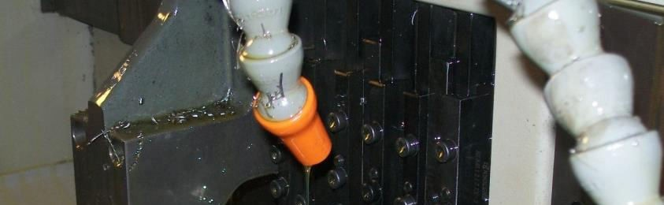
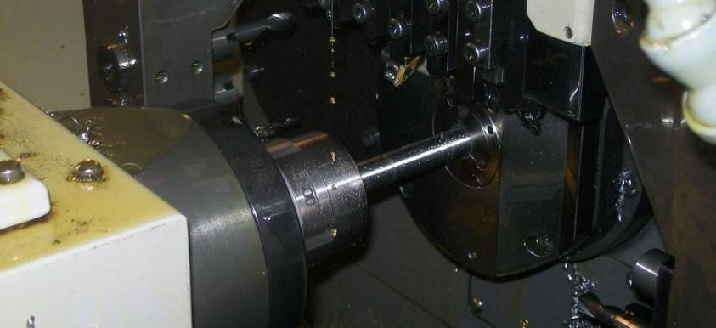
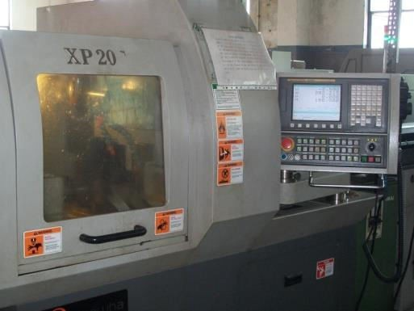
5 Axis CNC machines – Sliding auto
Facing, chamfering, countering, reaming, grooving, back chamfering & total length maintained in single setup
CRITICALITY:
Angular accuracy in 10 minute Hole accuracy in 15 microns
CNC SLIDING HEAD M/C TSUGAMI/ HANWA MAKE
rs.com
38

Slide 31
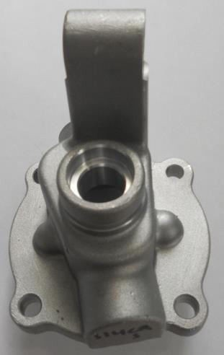
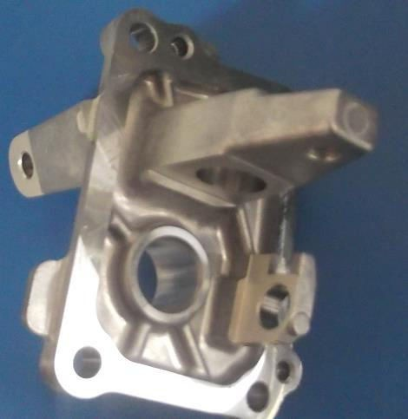



4 Axis VMC machines : Japanese Make
CRITICALITY:
Angular accuracy in 5 minutes
Hole accuracy in 15 microns
VMC – BROTHER JAPAN MAKE +
CNC ROTARY TABLE (4th AXIS) NIKKEN JAPAN MAKE
39

Slide 32




OTHER STRENGTHS : SPM MACHINES
MULTI ANGULAR DRILLING
MULTI MILLING
MILLING & DRILLING
35

Slide 33




Induction Hardening and Tempering Machine
Vertical I.H Machine
Stationary I.H Machine
Horizontal I.H Machine
Tempering F/c with PLC

Slide 34


Broaching Machine

Slide 35


Inspection Facilities
S.No. | Machine Types | Quantity
1 | Height Master | 7
2 | Surface Finish Tester | 4
3 | Roundness Tester | 1
4 | Vickers Hardness Tester | 1
5 | Millipore Testing Machine | 1
6 | Profile Projector | 2
7 | Eddy Current Sorter | 1
8 | Magna Flux testing | 2
9 | CMM | 2
10 | Contour Tracer | 1
11 | Universal Testing Machine | 1
12 | Index Measurement Device | 3
13 | Rockwell Hardness Tester | 5
14 | Spectro, Image Analyzer | 1
CMM

Slide 36






INSPECTION FACILITIES
SPECTRO
PROFILE PROJECTOR
ROUNDNESS TESTER
EDDY CURRENT TESTER
CONTOUR TESTER
ROUGHNESS TESTER

Slide 37





Testing Facilities in Metallurgical Lab
Micro Vickers
Image Analyzer
BHN Tester
Digital Rockwell M/c.
UTM Machine

Slide 38


